Slide 1
Project Management System
Viswanathan Hariharan

Slide 2
Contents
Introduction to Project Management system
Project planning
Project tracking

Slide 3
Introduction to Project Management system
Project Management system ensures success of projects
It consists of
  Management reviews
  Project management plan

Slide 4
Introduction to Project Management system
Management Reviews are of 2 types
  Quarterly review
  Phase-end reviews
Project Management plan consists of the following key components
  Project definition
  Project planning including estimates, activities, schedules, resources needed, reviews to be conducted
  Project monitoring & control
  Management reviews

Slide 5
Quarterly review
Senior management must review all important projects every Quarter
They should also review the status of the Process and its effectiveness in the organization, not just effectiveness in one project

Slide 6
Quarterly review
Project review consists of
  Milestone status
  Financial status
  Issues
  Review comments by process staff
Process review consists of
  Organization’s performance of productivity & quality
  Action plan to improve the organization capability

Slide 7
Phase review
Project Phase reviews are conducted by the Project manager along with representatives of all stakeholders such as project members, SQA team, business group & technical groups, etc.
These reviews are conducted at designated milestones, such as Project initiation, Requirement gathering, Prototype completion, Completion of High level design, Completion of Detail design, Coding, Testing, etc.
Basic aspects for review are
  Schedule
  Resources
  Quality
The phase review ensures coordination between business and technical groups and helps in reaching at a common understanding of the project status across different stakeholders

Slide 8
Project Management plan
Project management plan is prepared at the beginning of the project and kept updated through out the project
It defines the work and how it will be done
  Definition of the project – objective, goals, beneficiaries
  Estimate of time & resources
  Schedule & milestones
  Organization of teams
  Quality goals & Plan to ensure quality (such as reviews, testing,..)
  Change management plan
  Risk management plan
  Communication management plan
It is a powerful learning vehicle
  Benchmark to compare with actual performance
  See estimating errors & improve estimating accuracy

Slide 9
Sample Project Management Plan
From a book by Pankaj Jalote

Slide 10
Planning considerations
In majority of the cases customers do not accept the estimate of effort and schedule
  Main reason is – they want more than they can afford
It is best to reach early agreement on ‘essential’ functions and defer the rest
Quality products require harmonious team work between the users and the software engineers
  If agreement on scope is not reached, disagreements continue and will not be in the interest of the project
Hence delivery date should be determined based on start date, after agreement is reached

Slide 11
Project plan
Project plan (sub-set of PM plan) contains
  Goals & objectives
  Phases & scope of each phase
  Work Breakdown Structure
  Product size estimates (include contingency based on previous experience)
  Resource estimate
  Project schedule
  Quality goals & quality plan (how we plan to achieve quality)
Project plan is the basis for management review
As work definition is progressively refined, the plan is updated periodically
The updates to the plan are managed through quarterly and phase review process

Slide 12
Goals & Objectives
Users’ needs generally change as they look closely at the problem
Requirement change is thus a continuing problem for software engineering
Simple rules to manage this problem are:
  Implement in small incremental steps
  Freeze the requirements of each incremental step before starting design
  When requirements change during implementation, defer it to a subsequent increment
  If changes can not be deferred, stop work, modify requests, revise plan and start again on design
“Design of an aircraft can not be changed when it is flying. It needs to be on the ground”

Slide 13
Key considerations of design phase
List functional requirements together with other requirements such as performance & constraints of time & resources
Where possible produce a draft user’s manual or a prototype to clarify requirements
Identify users and their support needs such as installation support, documentation requirements, training needs, extent of user involvement during SDLC
Quantify applicable measures of success such as cost, schedule, performance, quality
Establish means (criteria) of determining success (target values) including responsibility for acceptance testing, etc.
Define continuing support requirements including defect reporting & correction and subsequent enhancement plans

Slide 14
Example of non-functional requirements
Credit authorization response should be within 30 seconds 90% of the time.
We want robust recovery when access to remote services such the inventory system is failing.
We language internationalization on the text displayed.
We need to be able to change business rules such as discount strategies
Can you give other example?

Slide 15
Work Breakdown structure
WBS has 2 parts
  Product structure (Typically hierarchical)
  Software process (reflects overall design process)
Product structure consists of various modules and sub-modules in the system
Software process consists of activities such as Detailed Design, Coding, Unit testing, etc.
Objective is to structure the WBS into small parts so that each part can be developed by an individual or a small team in a relatively short amount of time

Slide 16
Example of hierarchical structure of a software
Business modules
Marketing
  Customers
  Demand
  Campaigns
Production
  Inventory
  Purchase
  Production planning
Sales
  Orders
  Payment
Distribution
  Shipment
  Invoice
User Interface modules
Menus, Screens, etc.
Technical modules
Security
Logging
Persistent store

Slide 17
Example of a WBS
Activity | Effort (person days)
User interface development
Design | 20
Coding | 60
Unit testing | 12
Business components development
Architecture design | 20
Detailed design
Inventory | 8
Purchase order | 8
Shipment | 8
Invoice | 8
Payment | 8
Coding & Unit testing
Inventory | 24
Purchase order | 24
Shipment | 24
Invoice | 24
Payment | 24
Integration testing | 40
System testing | 40
Deployment | 12
Total | 364

Slide 18
Uses of WBS
WBS helps in creating a project schedule
WBS helps in monitoring & measuring the progress of the project – smaller the activities, more accurate is the measurement of progress
WBS can also be used to estimate the effort of each activity and then aggregating this to arrive at the effort for each module and ultimately for the complete project – smaller the activity, more accurate the estimate

Slide 19
Estimation
Basic steps of estimation are
Estimate size of the software
Convert the size into effort (person-months)
Distribute the effort across various phases of the project such as Design, Coding, Testing
Estimate the schedule for the project

Slide 20
Software Size
Size measures should be easy to use early in the project
Also the measure should be such that we should be able to readily measure the size once the work is completed
Examples of size measures are:
  Lines of code (LoC)
  Function Points
LoC are hard to relate to functional requirements but are easy to measure once the software in developed
Function points are easy to estimate (because it starts from user’s perspective). However it is hard to measure given a program code
So we generally convert the FP to LoC, based on historical data

Slide 21
Function points (FP): High level approach
Examine application requirement to determine the # of functions and their complexity level
  Different types of functions are:
    External Input
    External Output
    Inquiry
    Internal files
    External files
  Complexity levels can be Simple, Medium, High
Assign FPs to each Function & each File based on its complexity
Total the FPs. This is called Unadjusted FP or Raw FPs
Adjust total FPs by + or – 35% depending on the characteristics of the system, such as level of fault tolerance needed, level of distributed computing, level of performance, etc.

Slide 22
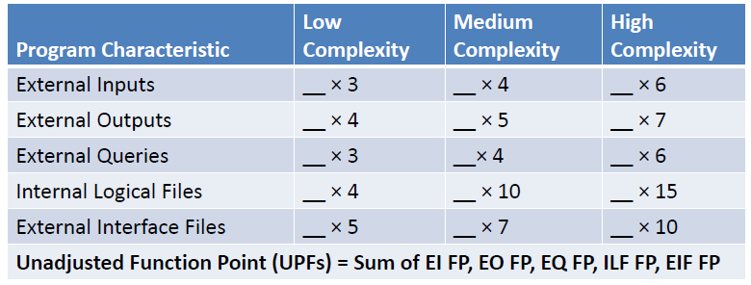
FPs for Functions & Files
Here are the FPs for different types of functions and files, based on their complexity

Slide 23
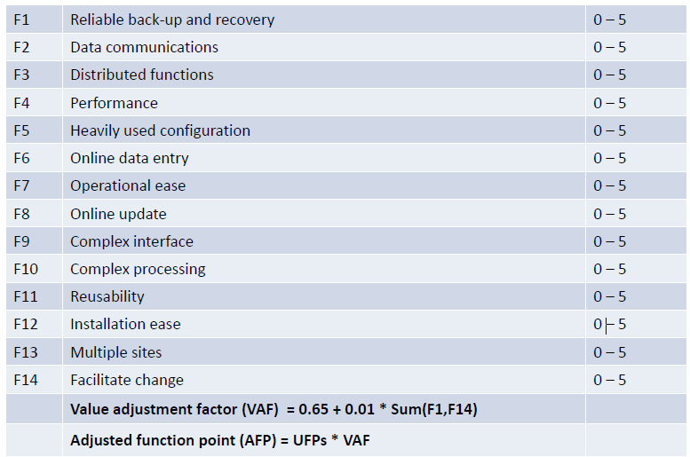
14 Software characteristics

Slide 24
Example of FP calculation
Functions | Name of Function | Type | Complexity | FP
 | Inquire balance | EQ | Low | 3
 | Withdraw money | EI | Medium | 4
 | Generate statement | EO | High | 7
 | ...
 | ...
Files | Name of File | Type | Complexity | FP
 | Account file | ILF | Medium | 10
 | Transaction file | ILF | Low | 4
 | TDS rates | EIF | Medium | 7
Total FPs (unadjusted) |  |  |  | 35
Adjustment factor |  |  |  | 1.1
Adjusted FP |  |  |  | 38.5

Slide 25
Estimating inaccuracies
Regardless of the method used, estimates are inaccurate
Most estimates have erred in being too low
This results in last minute crisis, late delivery and poor quality

Slide 26
Estimation inaccuracies…
Use multiple estimators and compare them (Wideband Delphi technique)
Earlier the estimate (in the lifecycle) less is known about the product, greater the inaccuracies
Hence add contingency depending on stage of development
Completed Project Phase | Code Growth Range %
Requirements | 100-200
High-level design | 75-100
Detailed design | 50-100
Implementation | 25-50
Function test | 10-25
System test | 0-10

Slide 27
Estimation inaccuracies…
Each organization needs to accumulate its own historical data and develop its own contingency factors

Slide 28
Productivity factors
We need productivity factor to convert size into effort (programmer months)
Ex. of productivity factor: 100 LoC per programmer day or 8 hours per FP
Productivity varies by
  Type of software product (business appl, system software, real time system, data analytics software, networking software, etc.)
  Technology used to develop software – Java, C++, Client – Server, Web technology, Mobile app
  Program size – bigger the program, higher the coordination effort, lower the productivity
  % of programs being changed during enhancement Ex. Product enhancement productivity is 70% of new development and Maintenance productivity is 25% of new development
  Have you come across any other factors that impact productivity?

Slide 29
Productivity factors…
Each organization should gather its own productivity data
  Different types of data to be gathered are effort for each type of activity such as
  Design,
  coding,
  testing,
  rework,
  training,
  project management, etc.
  and the corresponding sizes such as FP, LoC, # test cases, # defects, etc.
Categorize products / projects by type of software, size, domain, technology, etc. to arrive at average productivity of each type of project

Slide 30
Scheduling
Project schedule can be developed by spreading the effort over the planned product development phases
For example:
  20% for analysis & design
  45% for construction (coding)
  20% for testing (Integration test + System test)
  5% User acceptance test
  10% for Project management
As the requirements are not known at the beginning, it is difficult to estimate the effort for requirement gathering phase

Slide 31
Distribution across phases
Phase-wise distribution of resource
Phase | Small project (2000 Loc) | Large project (128,000 LoC)
High level design | 16% | 16%
Detail design | 26% | 23%
Code & Unit test | 42% | 36%
Integration & test | 16% | 25%
Phase-wise distribution of time
Phase | Small project (2000 Loc) | Large project (128,000 LoC)
High level design | 19% | 19%
Programming (Detail design + Code + Unit test) | 63% | 51%
Integration & test | 18% | 30%
Distribution of effort & time across phases differs depending on the size of the project

Slide 32
Project tracking
Sound Project management depends on the ability to determine project status
Hence the schedule should have enough checkpoints
One way to do this is Earned Value Analysis (EVA)

Slide 33
Earned Value Analysis - Example
Consider a project with the following estimates for effort, cost & time
Phase | Effort (Person months) | Cost ($) | Time (months)
High level design | 5.76 | 28,800 | 2.28
Detail design | 9.36 | 46,800 | 3.00
Code & Unit test | 15.12 | 75,600 | 4.56
Integration & test | 5.76 | 28,800 | 2.16
Total | 36 | 1,80,000 | 12.00
The planned value (not business value, but cost) of this project is $ 1,80,000
As the project progresses, money is spent and value gets created
At the end of High level design the value created is $ 28,800
At the end of Detail design, the value created is $ 28,000 + $ 46,000
If the effort spent is more than planned, then cost spent > value created
If project is delayed, then the value created is less than planned

Slide 34
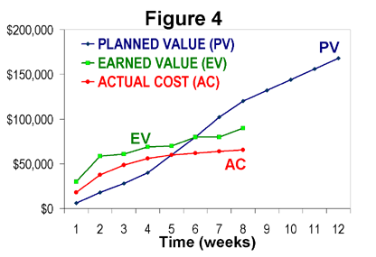
Planned Value, Earned Value and Actual cost

Slide 35
Final consideration
The most important need for good estimate is an estimation group
This group should
Ensure that estimates and actuals are stored in a database
Analyse & establish productivity factors & contingencies
Progressively improve estimates as more data is gathered and analysed
Assist development groups in preparing plans

Slide 36
Homework
Look at project schedules of some of the projects in your organization
Look at the estimation methods used in your organizations
What are the productivity factors

Slide 37
Appendix

